Slide 1

Business Case:
Bank Customer Churn
INFO583 : Introduction to Data Mining for Business | Final Project

Slide 2
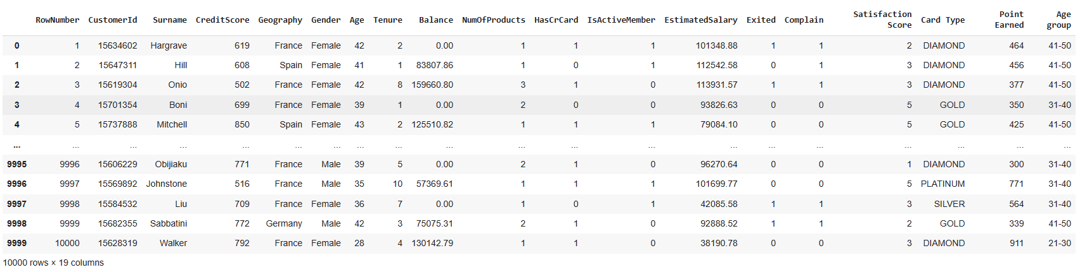
Dataset Description
Number of Observations : 10000
Number of variables : 19 variables
The present data set was gathered from Data Source : https://www.kaggle.com/datasets/kafayatyusuf/desktop

Slide 3
Data Dictionary
Input variables:
RowNumber: The sequential number assigned to each row in the dataset.
CustomerId: A unique identifier for each customer.
Surname: The surname of the customer.
CreditScore: The credit score of the customer.
Geography: The geographical location of the customer (e.g., country or region).
Gender: The gender of the customer.
Age: The age of the customer.
Tenure: The number of years the customer has been with the bank.
Balance: The account balance of the customer.
NumOfProducts: The number of bank products the customer has.
HasCrCard: Indicates whether the customer has a credit card (binary: yes/no).
IsActiveMember: Indicates whether the customer is an active member (binary: yes/no).
EstimatedSalary: The estimated salary of the customer.
Complain : Indicates whether the customer has a complain (binary: yes/no).
Satisfaction Score: Indicates whether the customer is satisfied.
Card Type: Indicates the type of card.
Point Earned: Indicates the number of points earned by the customer.
Age group: Indicates the range of the lower and upper ages of group where customer falls.
Output variable (target variable):
Exited: Indicates whether the customer has exited the bank (binary: yes/no).

Slide 4
Introduction
Business Problem Definition:
Problem: Customer churn poses a critical challenge for banks, leading to revenue loss and increased acquisition costs. Identifying at-risk customers and implementing targeted retention strategies is essential to mitigate churn and enhance profitability.
Objective: Utilize data analytics to predict and mitigate customer attrition, fostering loyalty and trust.
Impact:
Financial Implications: Revenue loss due to customer turnover and increased costs of acquiring new customers.
Social Implications: Erosion of trust and reputation within the community, hindering organic growth and word-of-mouth referrals.
Solution: Applying machine learning techniques to predict and analyze churn patterns using customer data such as demographics, transaction behaviors, and service interactions. This enables banks to identify at-risk individuals and implement proactive retention strategies.
Benefits:
Financial: Stabilization of revenue streams, reduction in acquisition costs, and increased profitability through customer retention.
Social: Reinforcement of customer trust and loyalty, fostering a supportive financial environment and positive brand reputation.

Slide 5
Business Case: Importance and Goal
Importance:
Customer churn has a direct impact on a bank's revenue and profitability.
Retaining customers is more cost-effective than acquiring new ones.
Predictive analytics can transform customer retention strategies, leading to improved customer satisfaction and brand loyalty.
By reducing churn, banks can ensure business continuity and foster a positive community image.
Primary Goals of the Project
Predictive Analytics: Develop models to predict customer churn based on demographic and behavioral data.
Targeted Retention Strategies: Identify at-risk customers and implement personalized retention initiatives.
Enhanced Profitability: Reduce revenue loss and acquisition costs while increasing customer lifetime value.
Positive Brand Reputation: Strengthen customer trust and loyalty, fostering a supportive financial environment.

Slide 6

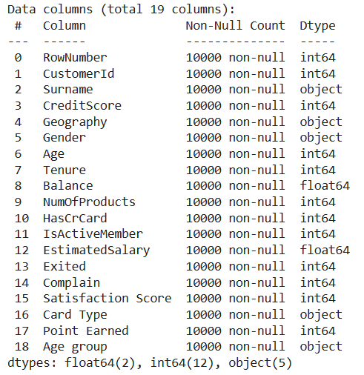
Descriptive Analysis
Number of columns: 19
Number of rows: 10000
Info of the data and datatypes
Datatypes : int64, float64 and object
Total no. of int64 and float64 (Numerical) : 14
Total no. of object (Categorical) : 5

Slide 7
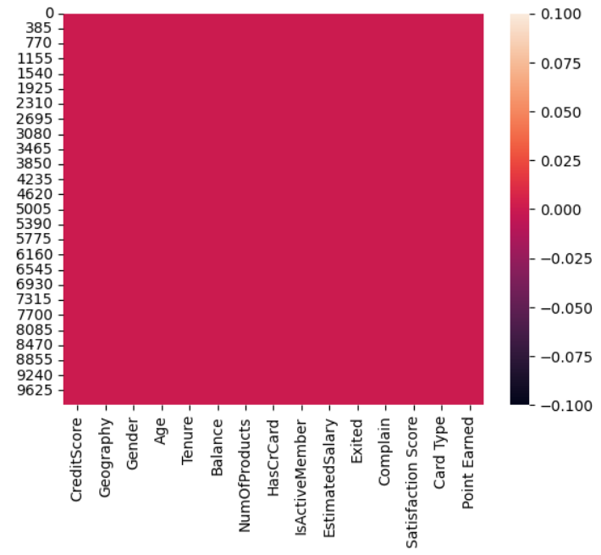
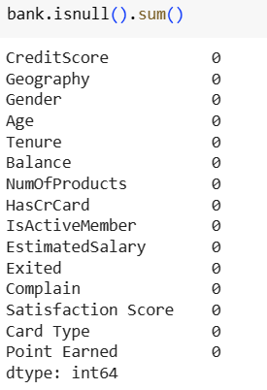
Descriptive Analysis - Missing Values
Distribution of missing values by column
Null values by column
Data set present no missing values (0%)

Slide 8
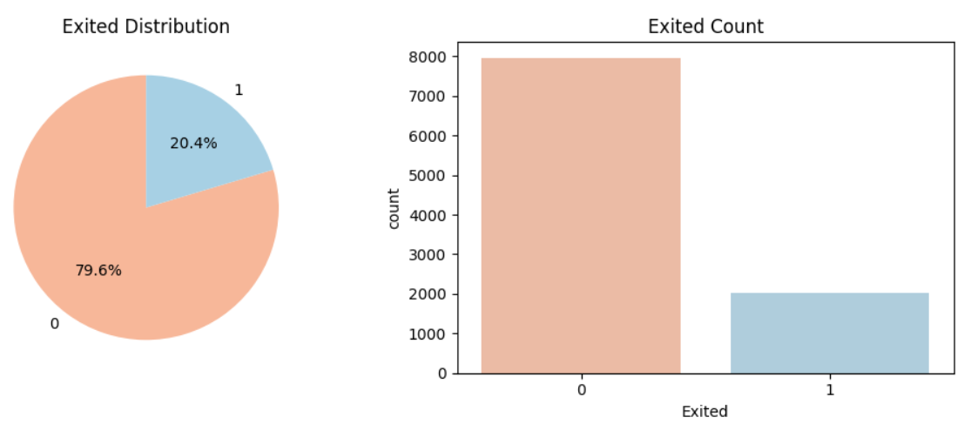
Data Visualizations – Target Variable
Distribution of target variable
From Graphic 1, around 20.4% of the customers have exited the bank and 79.6% have stayed(not exited).
From Graphic 2, the total number of exited customers are more than ~2000 and ~7900 has stayed.

Slide 9
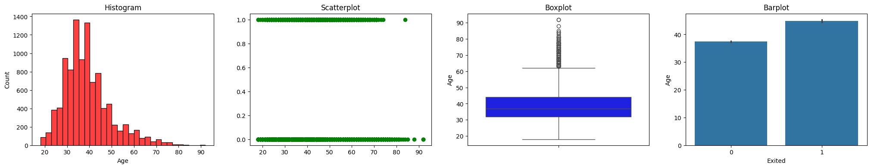
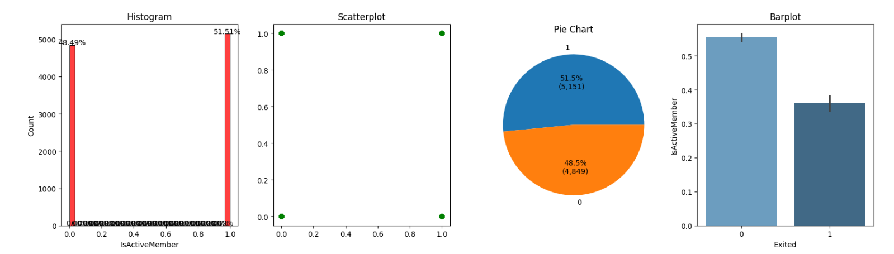
Data Visualizations - Relationship with target variable
Relationship between different Aged customers and whether they exited the bank
Relationship between Active Member and distribution of exited and stayed customer

Slide 10
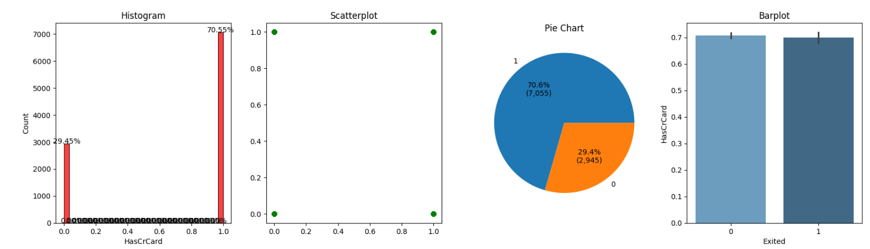
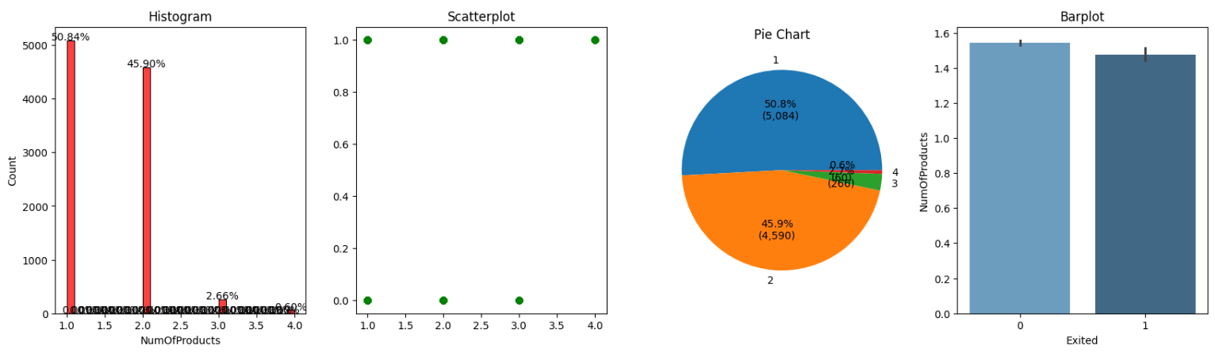
Data Visualizations - Relationship with target variable
Relationship between customers those having Credit Card and whether they exited the bank
Relationship between customers having different Number of Products and whether they exited the bank

Slide 11
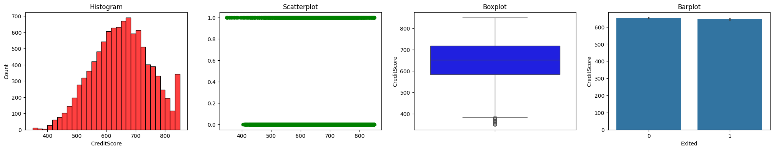
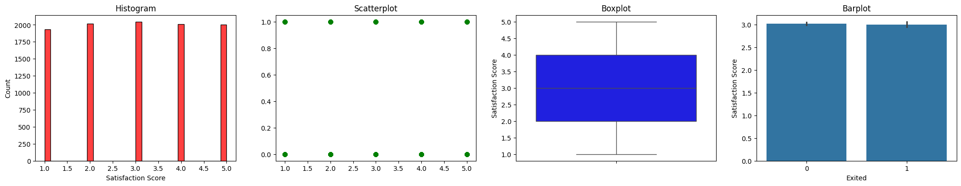
Data Visualizations - Relationship with target variable
Relationship between customers possessing Credit Score and whether they exited the bank
Relationship between satisfied customers and whether they exited the bank

Slide 12
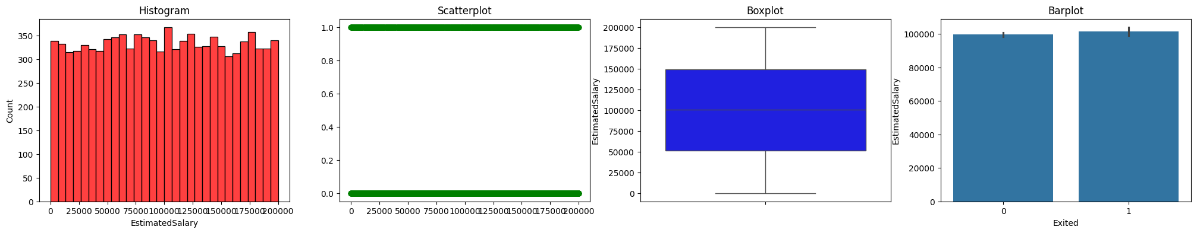
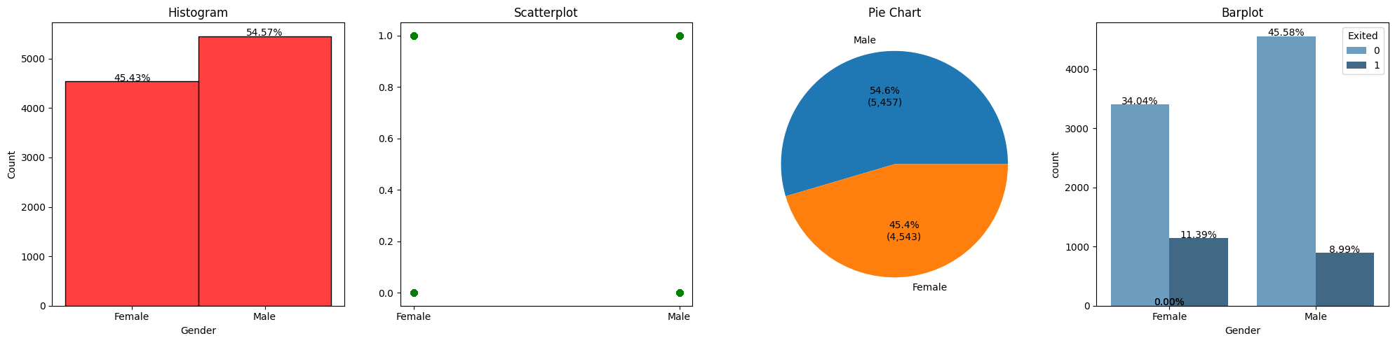
Data Visualizations - Relationship with target variable
Relationship between Estimated Salary of customers and whether they exited the bank
Relationship between Gender of customers and whether they exited the bank

Slide 13
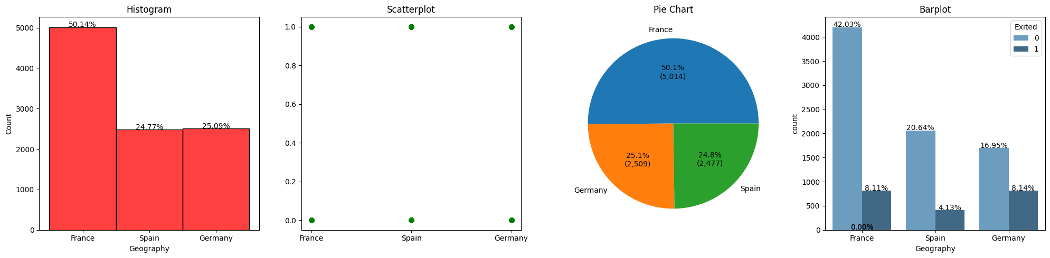
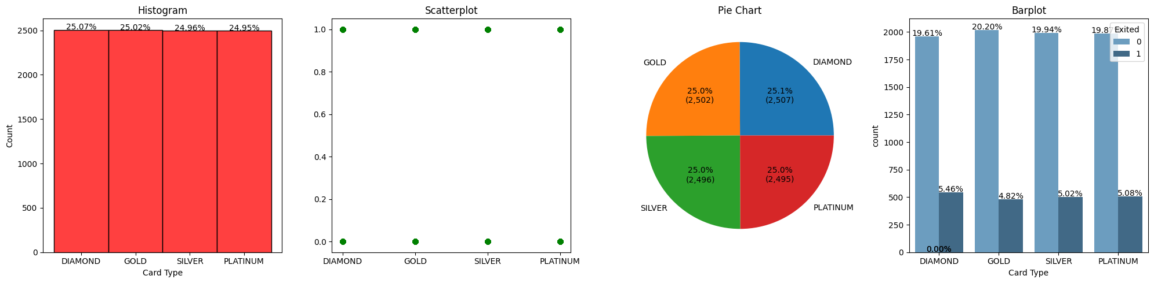
Data Visualizations – Relationship with target variable
Relationship between location of customers and whether they exited the bank
Relationship between customers having different Type of Cards and whether they exited the bank

Slide 14
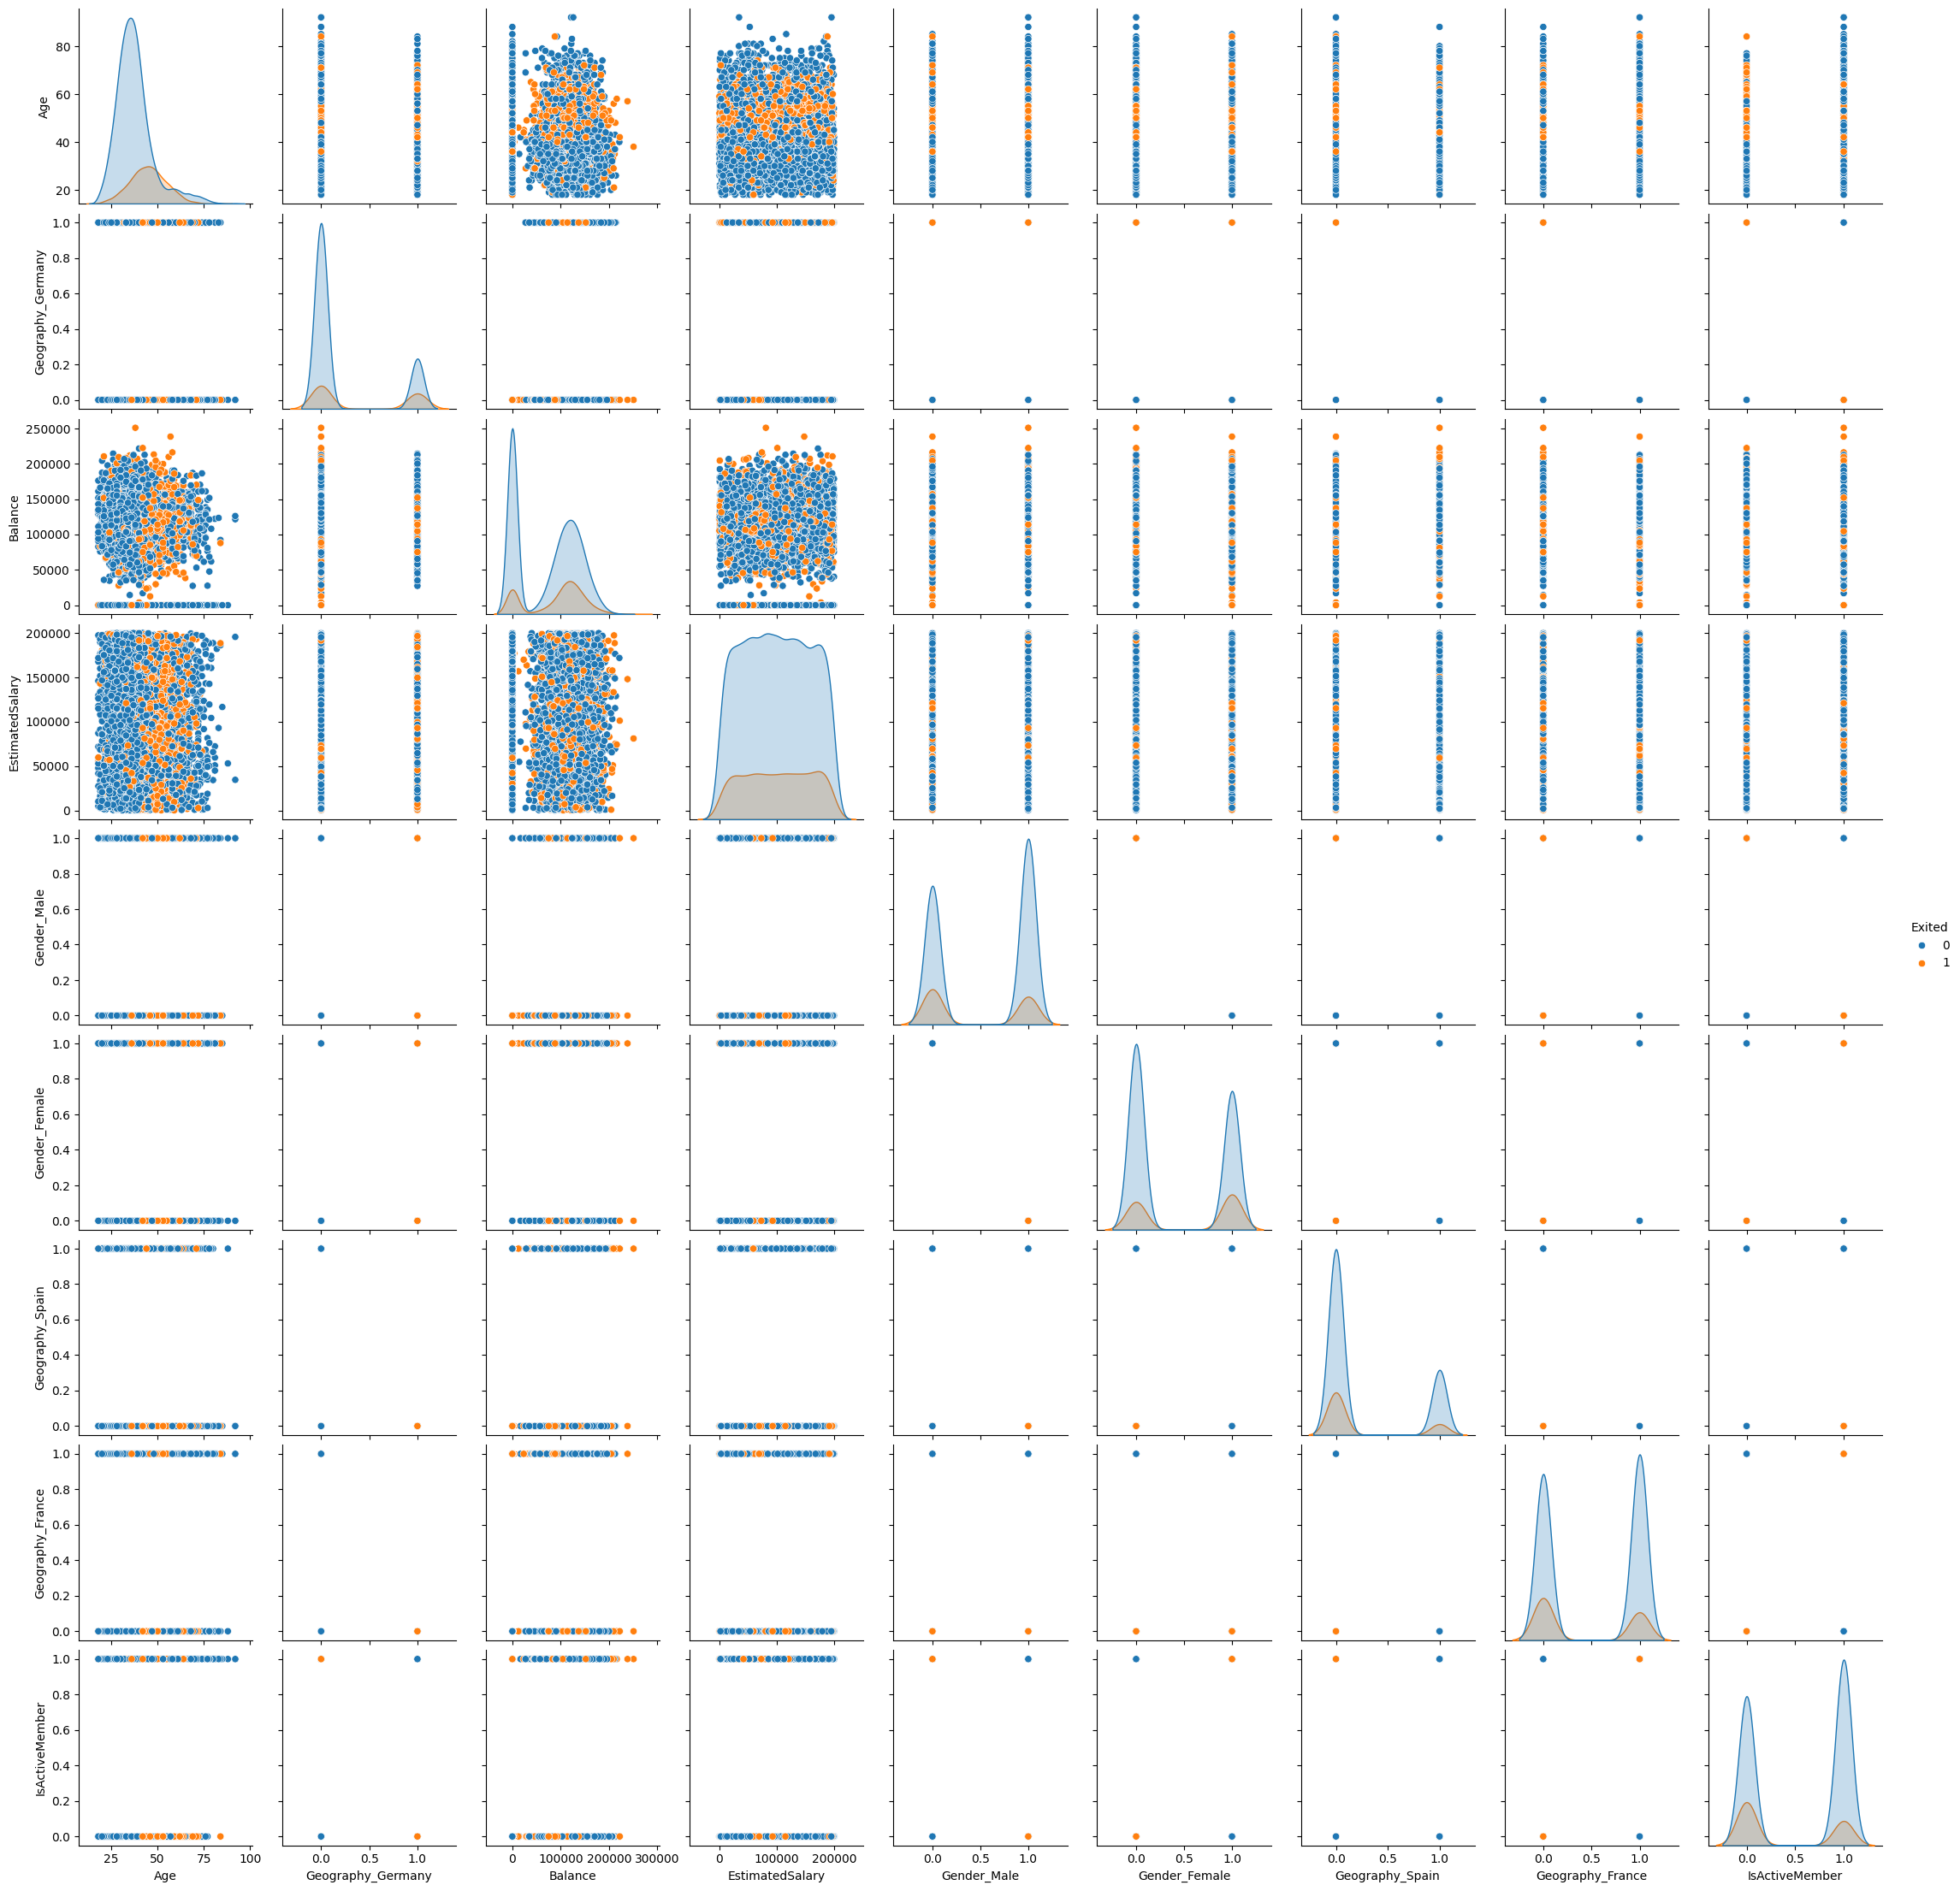
Data Visualizations – Pairplot
The graphic above, shows the pairplot of the relationship between important input variables and the target variable.

Slide 15
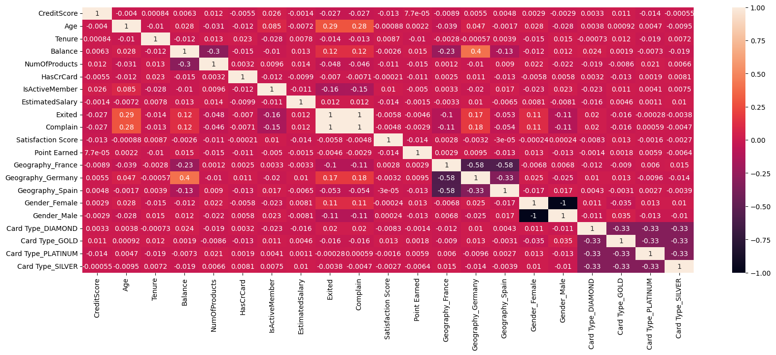
Data Visualizations - Correlation Matrix
Correlation Matrix
The graphic above shows the correlation matrix of all variables.

Slide 16
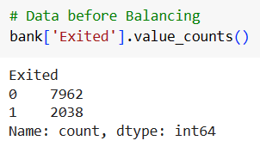
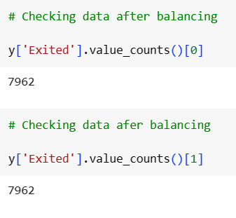
Data Preprocessing
Balancing Dataset
This table shows the dataset before balancing.
The final result of the dataset after balancing.

Slide 17
Modeling Approaches
Below are the different modeling approaches used in the prediction of the customer churn
Decision Tree
Random Forest
Boosted Tree
K-NN (k-nearest neighbors algorithm)
Logistic Regression
Naïve Bayes
Artificial Neural Networks
Deep Learning (keras Classification)

Slide 18
Comparison of Model Performance
Model | F1 | Recall | Precision | Accuracy | ROC AUC
Logistic Regression | 0.01 | 0.01 | 0.33 | 0.79 | 0.77
kNN | 0.00 | 0.00 | 0.00 | 0.79 | 0.50
Decision Tree | 0.41 | 0.27 | 0.88 | 0.84 | 0.50
Random Forest | 0.40 | 0.26 | 0.89 | 0.84 | 0.54
Boosted Tree | 0.57 | 0.47 | 0.74 | 0.85 | 0.66
Naïve Bayes | 0.33 | 0.53 | 0.24 | 0.54 | 0.67
ANN | 0.34 | 0.23 | 0.66 | 0.81 | 0.77
Deep Learning | 0.55 | 0.42 | 0.80 | 0.86 | 0.85

Slide 19
Summarizing Model Performances and selecting the best prediction model
Considering the simple interpretability of Logistic Regression, decision-makers need to choose this model.
Accuracy: 61.49% This indicates that the model correctly predicts whether the product reached on time or not about 61.49% of the time. Accuracy is a measure of overall correctness.
Recall : 52.28% This tells us that the model can correctly identify products that did not reach on time (positive instances) about 52.28%. It’s essential if the consequences of not reaching on time are significant. Minimizing the number of late deliveries is crucial, and that is why is prioritized.
the sensitivity to business goals in our model
Specificity: 67.58% This indicates that the model is good at correctly identifying products that did reach on time (negative instances) about 67.58% of the time. It's crucial if avoiding false alarms (false positives) is important.

Slide 20
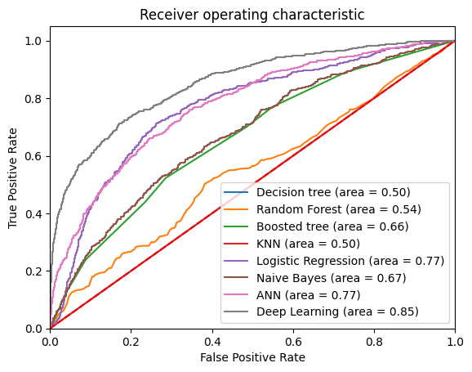
Model Selection
AUC for ROC Curve in different prediction modeling techniques
Deep Learning (DL) = Highest ROC AUC

Slide 21
Conclusion: Model Performance and Insights
Deep Learning : Considering the powerful interpretability of Deep Learning, decision-makers need to choose this model.
Accuracy
55%
0.85
ROC AUC
Accuracy is a measure of overall correctness.
The Area Under the Receiver Operating Characteristic (ROC) Curve is a measure of the model's ability to discriminate between the positive and negative classes
Recall
42%
This tells us that the model can correctly identify products that did not reach on time
55%
F1-Score
Precision
80%
It indicates that the dependent variable is predictable from the independent variables.
This indicates that the model is good at correctly identifying products that did reach on time

Slide 22
Next Steps and Strategic Recommendations
Leverage Customer Feedback for product satisfaction
04
Analyze specific product types and categories, minimize complaints of customers.
(Investigate False Negatives in specific categories)
02
05
Continuously monitoring the model's performance over time.
As the business evolves or external factors change, the model may need adjustments to maintain its effectiveness.
03
The business impact of customer trust and the way to provide better service.
01
Additional data analysis with cross-validation is suggested to validate
results and ensure the model's robustness.

Slide 23
THANK YOU

